Slide 1

Self_Driving car
Task-1
Supervisor:
Dr.GAMAL EL-SHIKH

Slide 2

Team members
Abdelrahman Sherif Ali THE LEADER
Asmaa Mohamed Abdelhamed
Moamen Ahmed Mourad
Mohammed Alaa
Mahmod Mohamed
Mohamed Nageh
Sondos Reda Ghareeb
Mohamed Hossam

Slide 3
How it's going to be
The project idea
The connection between the web site & the car
Present the car while it’s working
Overview of the basic components

Slide 4

The project idea
Control the car across the web site via the ESP8266 throughout the MPU6050 readings

Slide 5
The connection between the web site & the car
for controlling an autonomous car via an ESP8266 microcontroller. The system allows users to remotely control the car and view real-time data on its movements and actions by connecting to the ESP network which called Autonomous Car and password is auto2244 ,then can go to 192.168.1.100 which operates as the Server Side.

Slide 6
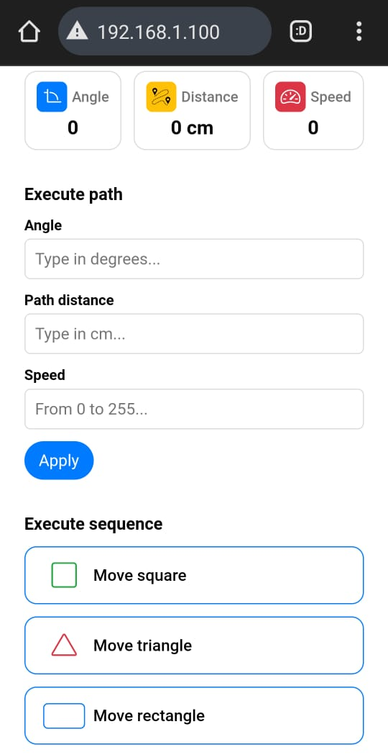



Slide 9
Present the car

Slide 10

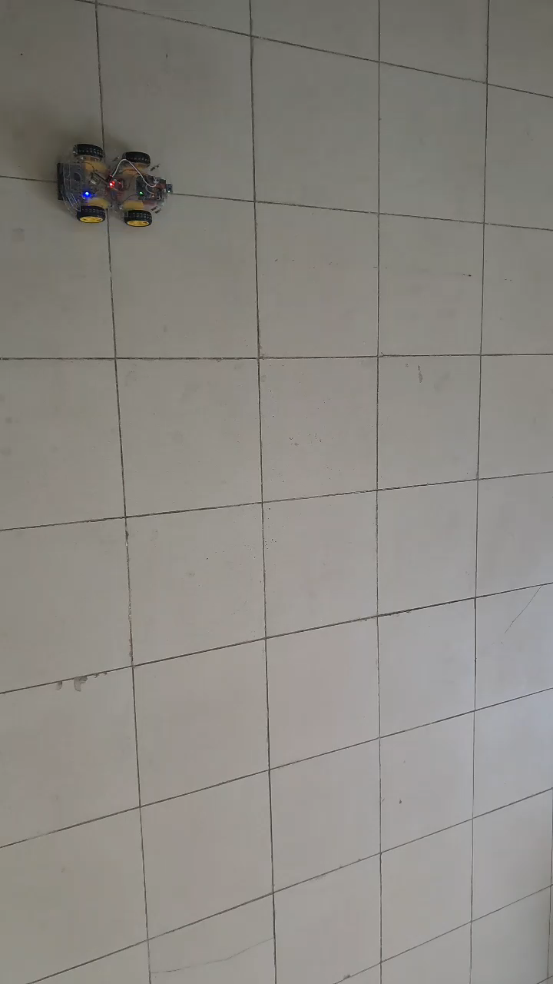

Slide 11

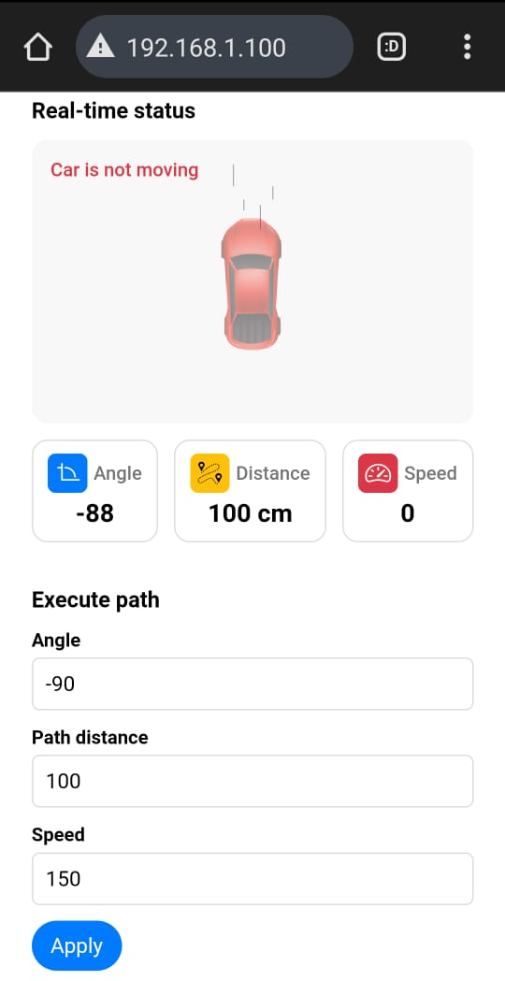

Slide 12
The basic components
Mpu6050
Esp8266
HC-020k

Slide 13
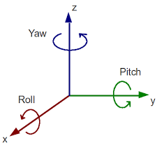
Mpu6050
The MPU-6050 is a Motion Tracking Device that combines a 3-axis gyroscope and a 3-axis accelerometer in a single chip. It is commonly used in various electronic applications for measuring motion and orientation.

Slide 14
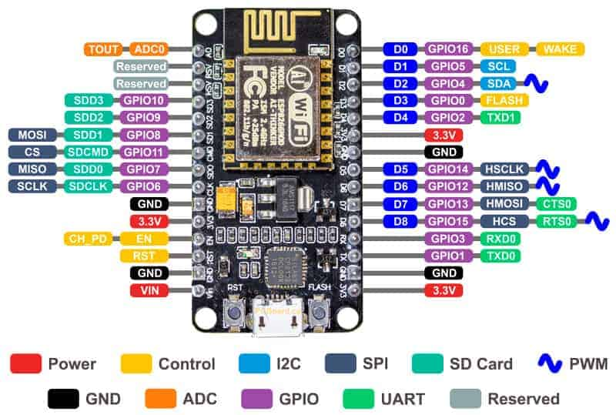
Esp8266
The ESP8266 is a low-cost, highly integrated Wi-Fi microcontroller chip designed by Espressif Systems. It's widely used in IoT (Internet of Things) projects due to its ease of use, low power consumption, and robust wireless connectivity.

Slide 15
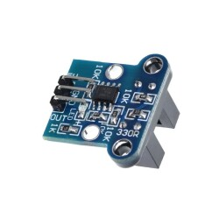
HC-020k
The HC-020K Encoder Module is a versatile device commonly used in robotics and automation projects. It features an incremental rotary encoder that translates rotational position into digital signals, allowing for precise motion control and feedback

Slide 16
Thank you
Any questions?

